Slide 1
The ChocAn Data Center
Ethan Fleming, Long Vo, Tommy Ngo, Alex Staley, Trent Wilson, and Carl Bunt

Slide 2
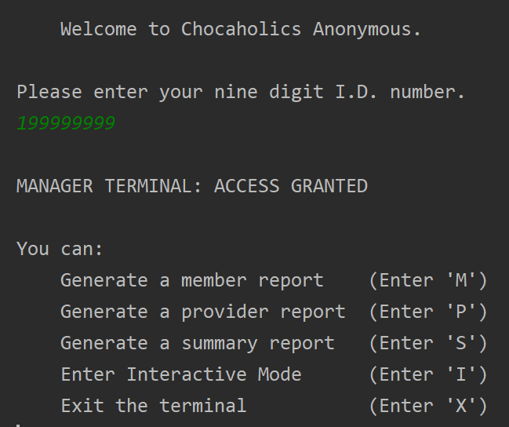
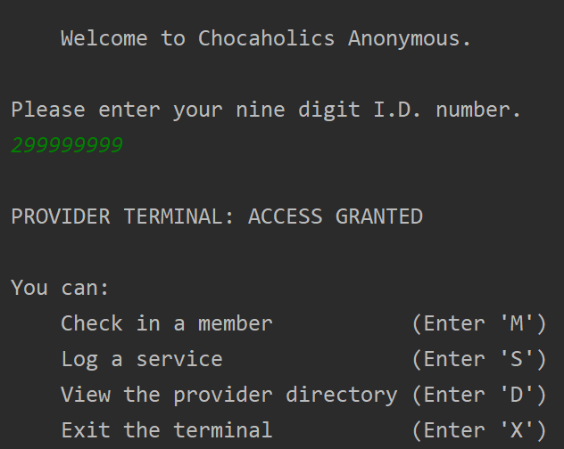
Logging in...
A manager or a provider can log in by scanning their ID card:

Slide 3
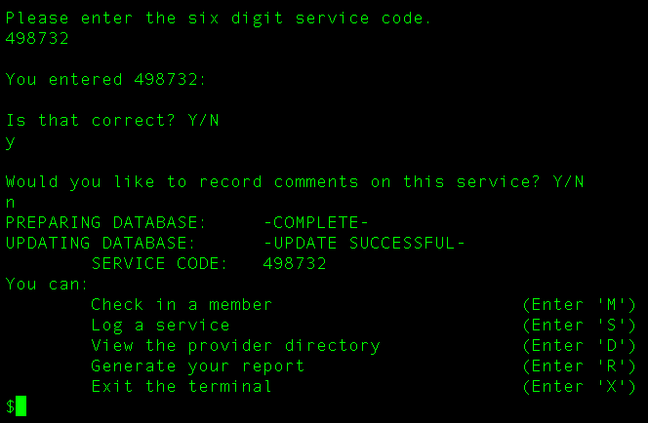
Providing services...
A ChocAn service provider can record a service provided to a ChocAn member.

Slide 4
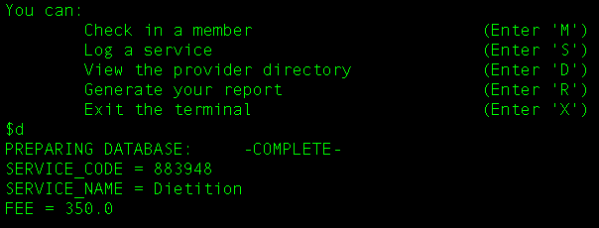
Displaying the provider directory
A provider can review the directory of ChocAn-approved services, along with their associated codes and fees.

Slide 5
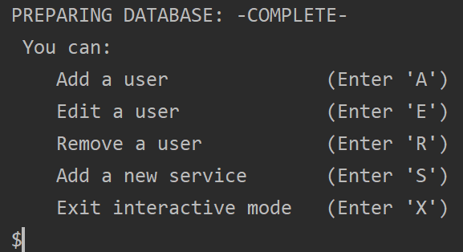
Interactive Mode
A manager can enter interactive mode to add new members and providers to the database, edit providers’ and members’ information, and add newly offered services to the provider directory.

Slide 6
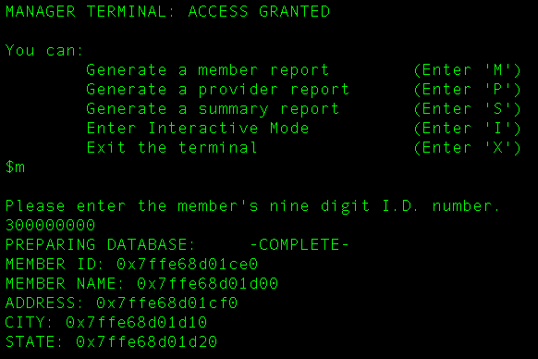
Generating reports...
A manager can generate reports for members, providers, and a summary report. These reports are written to their own respective files.

